Slide 1
B-Tree
Notes:
*** Even -> both are valid. Usually people add then split

Slide 2
Motivation
So far, we have assumed that we can store an entire data structure in the main memory (RAM) of a computer.
When data is too large to fit in main memory, the data structure must resides on disk and the number of disk accesses becomes important.
A disk access is expensive compared to a typical computer instruction.
Although disks are cheaper and have higher capacity than main memory, they are much, much slower because they have moving mechanical parts compared to the purely electronic media.
One disk access is worth thousands of instructions.
The number of disk accesses will dominate the running time.
Notes:
Worth 200,000 instruction

Slide 3
Motivation Cont..
Secondary memory (disk) is divided into equal-sized blocks (typical sizes are 512, 2048, 4096 or 8192 bytes)
The basic I/O operation transfers the contents of one disk block to/from main memory.
Our goal is to devise a multiway search tree that will minimize file accesses.

Slide 4
m-ary Trees
K1 K2 K3 K4
node
key
T1
T2
T3
Etc.
K < K1
K1 < K < K2
m-ary search tree allows m-way branching (m children).
A node in a m-tree contains multiple keys (K1,K2,K3 etc).
Each piece of data stored is called a "key", because each key is unique and can occur in only one location.
The keys in a node serve as dividing points separating the range of keys.
In applications there would be a record of data associated with each key (e.g, student record, phone number).
Order of subtrees is based on parent node keys.
If each node has m children and there are n keys then the average time taken to search, insert and delete from the tree is log_{m}n.

Slide 5
B-Tree
Ideally, a tree will be balanced and the height will be log n where n is the number of nodes in the tree. To ensure that the height of the tree is as small as possible and therefore provide the best running time, a balanced tree structure like a AVL tree, b-tree, or red-black tree must be used.
B-tree is a self-balancing tree data structure that keeps data sorted and allows searches, sequential access, insertions, and deletions in logarithmic time.
The B-tree is a generalization of a binary search tree in that a node can have more than two children.
The idea is that we leave some key spaces open. So an insert of a new key is done using available space (most cases).
Unlike self-balancing binary search trees, the B-tree is optimized for systems that read and write large blocks of data.

Slide 6
The B-tree algorithm minimizes the number of times a medium must be accessed to locate a desired record, thereby speeding up the process.
The B-tree algorithms copy selected pages from disk into main memory as needed and write back onto disk the pages that have changed. B-tree algorithms keep only a constant number of pages in main memory at any time; thus, the size of main memory does not limit the size of B-trees that can be handled.
In a practical B-tree, there can be thousands, millions, or billions of records.
Real-world B-trees are of higher order (32, 64, 128, or more). For a large B-tree stored on a disk, we often see branching factors between 50 and 2000.

Slide 7
A B-tree node is usually as large as a whole disk page, and this size limits the number of children a B-tree node can have.
B-trees are a good example of a data structure for external memory. It is commonly used in databases and filesystems. (e.g., Used in Mac, NTFS, OS2 for file structure. SQL Server https://technet.microsoft.com/en-us/library/ms177443(v=sql.105).aspx ).
Real world database indexes with millions of records have a tree depth of four or five.

Slide 8
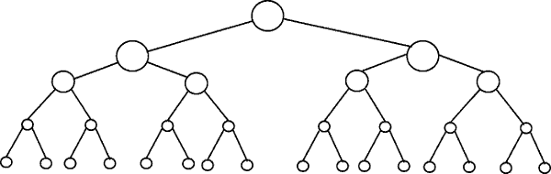
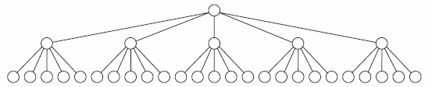
Binary tree of 31 nodes has 5 levels
A 5-ary tree of 31 nodes has only 3 levels

Slide 9
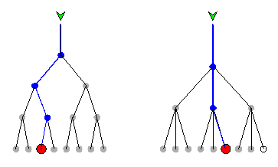
Binary Tree vs B-Tree
B-trees save time by using nodes with many branches, compared with binary trees, in which each node has only two children. When there are many children per node, a record can be found by passing through fewer nodes than if there are two children per node.
The tradeoff is that the decision process at each node is more complicated in a B-tree as compared with a binary tree. A program is required to execute the operations in a B-tree. But this program is stored in RAM, so it runs fast.

Slide 10
Properties of a B-Tree
Order of a tree = maximum number of children per node.
B-tree of order m has the following properties:
The root is either a leaf or has between 2 and m children.
Every node has at most m children (pointers).
Every node except for the root and the leaves has at least ⎡m/2⎤ children.
A non-leaf node stores up to m-1 keys.
All leaves appear at the same level.

Slide 11
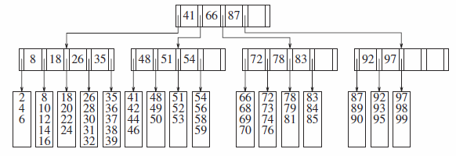
A B-tree of order 5
Notice that all non-leaf nodes have between 3 and 5 children (and thus between 2 and 4 keys).

Slide 12
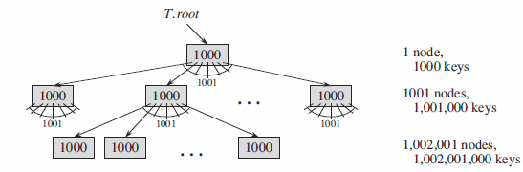
How many keys a B-tree can store with a branching factor of 1001 and height 2?
Max number of keys at depth d in a B-tree= m^{d} *k
m = order of tree
k = max number of keys per node
d=depth
Since we can keep the root node permanently in main memory, we can find any key in this tree by making at most only two disk accesses.

Slide 13
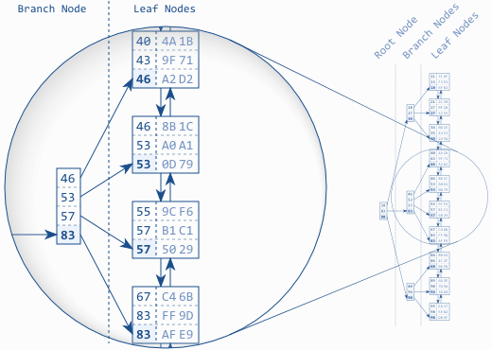
B-tree Structure
An index with 30 entries.
An implementation of B-Tree that is used in some databases: Each branch node entry corresponds to the biggest value in the respective leaf node.
48
56
77

Slide 14
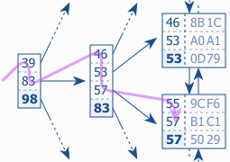
B-Tree Traversal
The figure shows an index fragment to illustrate a search for the key “56”. The tree traversal starts at the root node on the left-hand side. Each entry is processed in ascending order until a value is greater than or equal to (>=) the search term (56). In the figure it is the entry 83. The database follows the reference to the corresponding branch node and repeats the procedure until the tree traversal reaches a leaf node.
48
56

Slide 15
Insertion
Insert k into B-tree of order m.
We find the insertion point (in a leaf) by doing a search.
If there is room then enter k, keeping the node’s elements ordered.
Else, promote the middle key to the parent & split the node into 2 nodes around the middle key.
If the splitting backs up to the root, then make a new root containing the middle key.
Note: the tree grows from the leaves, balance is always maintained.

Slide 16
Insertion Example – B-Tree of order 3
G
C
I | M
A
D | E
H
J | K
N | O
L is inserted into the above tree.
G | K
I | K | M
C
I
M
K is promoted again, this gives the new tree:
H
J
L
N | O
A
D | E
H
J
L
N | O

Slide 17
Splitting Nodes
A | B | C
Middle key is promoted
Join its parent or create a new root
T1
T2
T4
T3
B
A
C
T1
T2
T3
T4

Slide 18
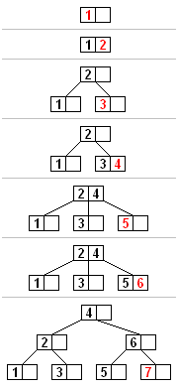
Insert the numbers 1 to 7 into a B-Tree of order 3

Slide 19

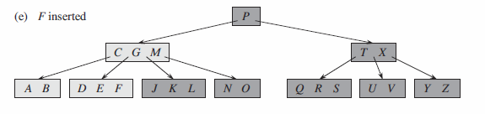
Show the final B-Tree after inserting keys B, Q, L, and F into the following B-tree of order 6

Slide 20
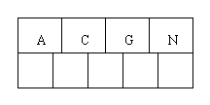
Insert the following letters into an empty B-tree of order 5: C N G A H E K Q M F W L T Z D P R X Y S
Order 5 means that a node can have a maximum of 5 children and 4 keys.
All nodes other than the root must have a minimum of 2 keys.
The first 4 letters get inserted into the same node, resulting in this picture:

Slide 21
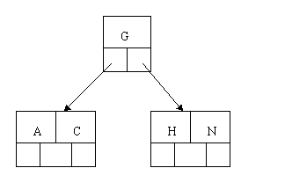
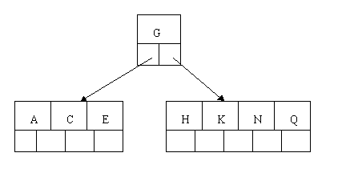
When we try to insert the H, we find no room in this node, so we split it into 2 nodes, moving the median item G up into a new root node.
Inserting E, K, and Q proceeds without requiring any splits:

Slide 22
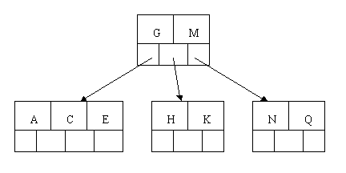
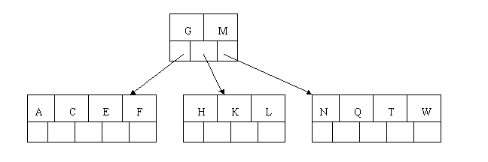
Inserting M requires a split. Note that M happens to be the median key and so is moved up into the parent node.
The letters F, W, L, and T are then added without needing any split.

Slide 23
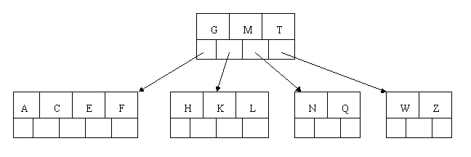
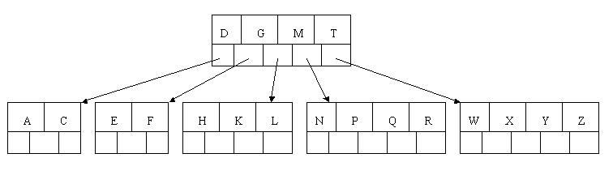
When Z is added, the rightmost leaf must be split. The median item T is moved up into the parent node. Note that by moving up the median key, the tree is kept fairly balanced, with 2 keys in each of the resulting nodes.
The insertion of D causes the leftmost leaf to be split. D happens to be the median key and so is the one moved up into the parent node. The letters P, R, X, and Y are then added without any need of splitting:

Slide 24
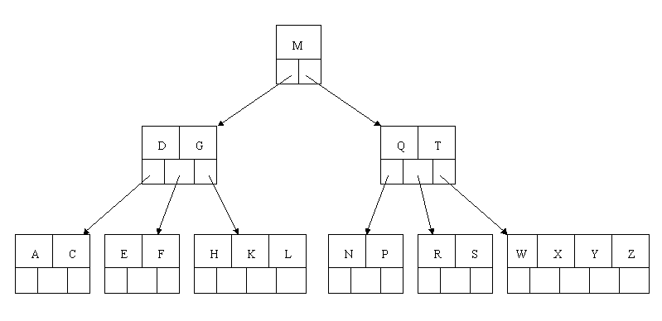
Finally, when S is added, the node with N, P, Q, and R splits, sending the median Q up to the parent. However, the parent node is full, so it splits, sending the median M up to form a new root node. Note how the 3 pointers from the old parent node stay in the revised node that contains D and G.

Slide 25
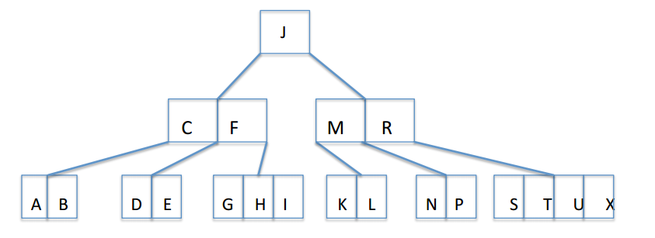
Insert the following letters into an empty B-tree of order 5: A G F B K D H M J E S I R X C L N T U P

Slide 26
Insert 50, 19, 21, 66, 84, 29, and 54 into a B-Tree with order 3
21
50
19, 50
19, 21, 50
19, 21, 50
19
50
21, 66
21, 66
21
21
19
29, 50
84
19
50
84
19
50, 66, 84
19
50, 66
50
21, 66
21, 50, 66
21
66
19
29, 50, 54
84
19
29
54
84
19
29
54
84

Slide 27
Useful links
B-Tree applet https://www.cs.usfca.edu/~galles/visualization/BTree.html
B-Tree talk
http://www.csanimated.com/animation.php?t=B-tree

Slide 28
Acknowledgments
Dr Frederic Maire Brisbane, Queensland, AUSTRALIA
Dave Bockus notes
Introduction to Algorithms, (3rd ed.), Thomas H. Cormen, Charles E. Leiserson, Ronald L. Rivest, Clifford Stein. Chapter 18
Data Structures Using C++, 2nd Edition, Malik, 2009. Chapter 11
Data Structures and Algorithms in C++ (4rd ed.), Adam Drozdek, 2005. Chapter 7
Algorithms - Robert Sedgewick and Kevin Wayne 2011 4th Edition
Data Structures and Algorithm Analysis in C++, Mark Allen Weiss, 4th ed, 2013. Chapter 4.7
Data Abstraction & Problem Solving with C++, Carrano, 6th ed. Chapter 21.
A Practical Introduction to Data Structures and Algorithm Analysis, 3rd ed. Shaffer, 2010. Chapter 10.5
http://cis.stvincent.edu/html/tutorials/swd/btree/btree.html
http://www.bluerwhite.org/btree/
http://searchsqlserver.techtarget.com/definition/B-tree
http://www.semaphorecorp.com/btp/algo.html
http://use-the-index-luke.com/sql/anatomy/the-tree
http://www.cs.carleton.edu/faculty/jgoldfea/cs201/spring11/inclass/Tree/BTreefinalNew.pdf

